Slide 1
JOB NO : 02
SUB NAME : Microcontroller Application
JOB NAME : Led Array In Microcontroller IC
Name : Ashim Rudra Paul
Roll : 493549

Slide 2

INTRODUCTION
This Flashing or Dancing Array LED circu used for decoration purpose or asan indicator. Flashing or dancing speed of LED's can be varied with the help ofvariable resistor and various dancing pattern of light can be formed by slightchange in the circuitThe circuit is based on Ic pic16F84A and with few more components such asresistors and transistor.

Slide 3
Requirement gathering
I am first observing how to add the necessary microcontroller kit to my project, and also observing how to complete the project given by sir on time by providing all the necessary knowledge about microcontroller. We have collected all the knowledge and information about the project from Humayun sir.Our teacher Humayun Rashid sir in this institute “Sylhet Polytechnic Institute”. We are following some strategies.This collected necessary assembly. There...
* Background study*
Data collection
the interview Questionnaire.

Slide 4

overview
Back ground Microcontroller defined. I Types of 16f877A microcontrollers . Necessary Hardware kit and Software :
Pic c compiler
Proteus 8 professional
PIC16F84A microcontroller
LED
8 MHz crystal oscillator
104 pF ceramic capacitor
10K ohm resistor
330 ohm resistor
Breadboard
5V source

Slide 5

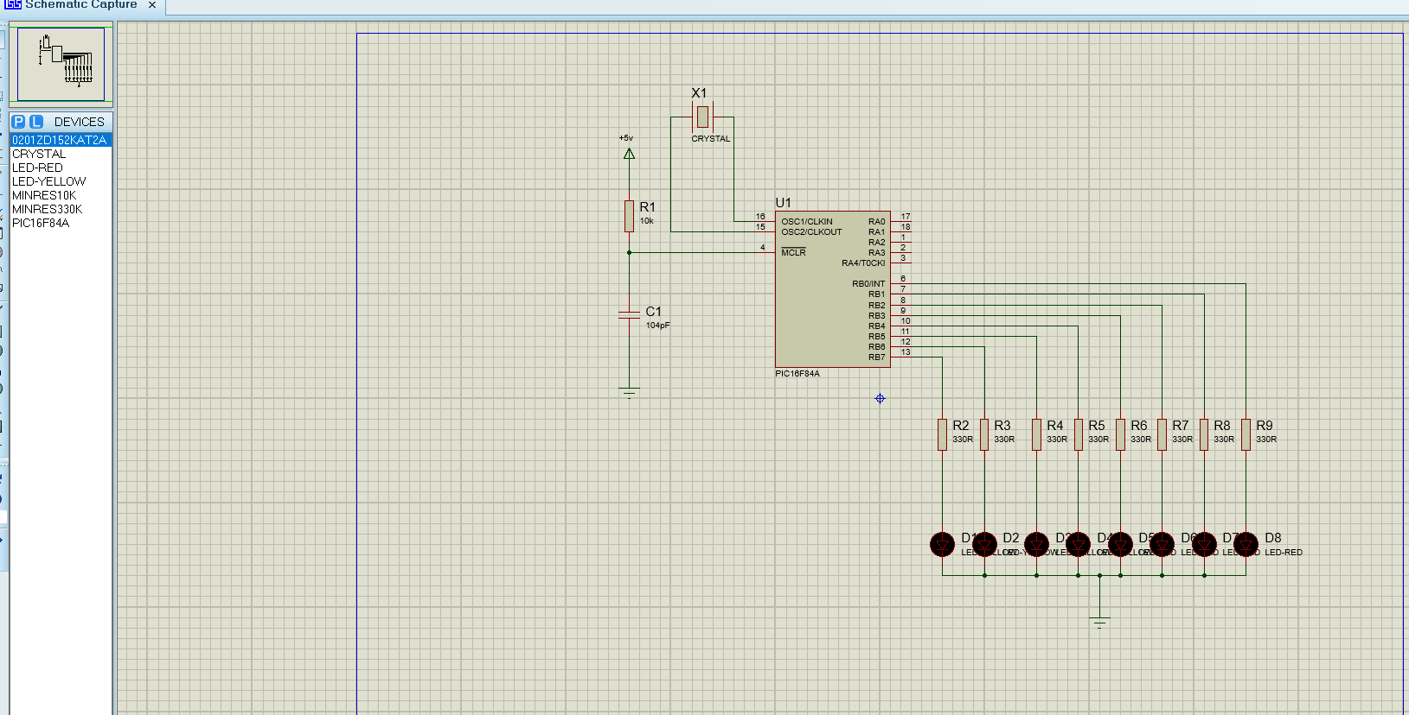
Circuit design Circuit Schematic Diagram for the led flasher is shown below.

Slide 6

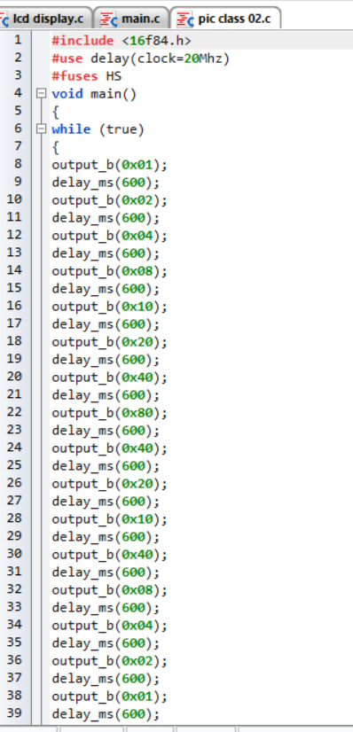
Coding The code for making LED blink using PIC16F84A is shown below.

Slide 7
Implementation
The circuit on the left side of PIC is its basic circuit, we need this circuit in order to power up the PIC and to give it a frequency on which it operates. Like in this diagram, I have used crystal oscillator of 20MHz, which is its frequency of operating. You can operate it at different frequencies e.g. 4MHz ,10MHz , 16MHz, 20MHz etc
But keep this thing in mind that if you change the oscillator then you must change the capacitors as well e.g. for 20MHz the capacitors will be of 104pF.
Vdd for PIC is 5V , if you have a 5V battery then its cool but mostly adapters are of 12V. So if you have 12V adapter then use 7805 which converts the 12V into 5V.
Now come to the circuit on the right side of the PIC, these are simple LEDs which I have connected with PortB of PIC Microcontroller.
On the other side of these LEDs is a resistor just for current control and then a GND (ground).
Now when we make any of these pins high then respective LED will turn ON and when we make that pin low, LED will turn OFF.
NOTE :
Pin High means its at 5V and LOW means its at 0V.
Now let's come to the programming part. Open your ‘Pic C’ For PIC Compiler and create a new project in it.
Make sure that you select PIC16F84a in Device Name and keep the frequency to 20MHz.
Watch the video, if you got into any trouble, its attached at the end of this article.
Now place the below code in your Pic C for PIC Compiler:
// ************ LED Blinking Project using PIC16F84a void main() { trisb= 0x00; while(1) { portb = 0x00; delay_ms(2000); portb = 0xFF; delay_ms(2000); } }

Slide 8

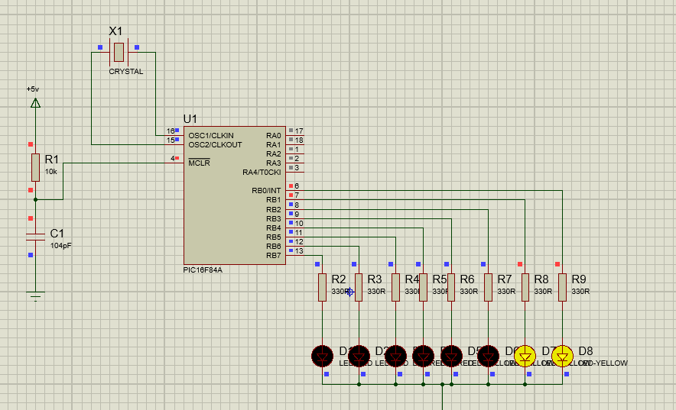
Now let me explain the code, it's a very simple code just five to six lines.
void main () This is the main function of program, the compiler always come straight to this part and leaves the rest it will execute only what is written under its braces.
trisb = 0x00; This code will tell the compiler to use the pins as output. If we were using a sensor on any pin then we have to make it 1.
while(1) This one runs continuously means pic will execute the code with its braces forever and it never stops.
and in the next two lines we make the pin high and then low which is connected to the LED so now the LED will turn ON and then OFF continuously.
You can also increase the delay between these lines if you want to increase the duration of ON / OFF.
Now Build your project to get the hex file.
Upload this hex file in your Proteus Simulation and then run your simulation.
If everything goes fine then you will get something as shown in below figure:

Slide 9

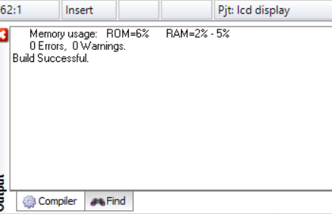
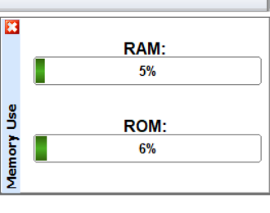
Testing coding: The coding is completely fine, there are no errors. An example is shown in the image below :

Slide 10
Conclusion
Pic-16f84a IC is used to generates a continuous output in the form of square wave which turns the LED on and off.Here additionally going to calculate the capacity and varying capacity with the resistant capacitor.Finally this project is calculating the pulse rate for defining the frequency and time period.

Slide 11

Thanks For Your Attention

